Slide 1


Company Profile 2024
Namaa InfoLogistics
We are subject matter experts in digitalizing Records & Information
Namaa InfoLogistics is a leading company in the Records & Information Management services and applications development, Namaa team owns 30+ years of practical experience in digitalizing organizations'’ records & information….

Slide 2


①
Brief outlining-Namaa InfoLogistics
Presentation Highlights
②
Our satisfied clients
Key Topics
Partners & Contracts
③
④
Software Solutions
⑤
Professional Services Overview

Slide 3

①
About Namaa InfoLogistics
Namaa InfoLogistics is Information Technology & Records Management Company
headquartered in Egypt
30 + years experience

Slide 4
About Namaa InfoLogistics
Vision
To be the most preferred IT & BPO partner in MEA region through delivering the best in class software solutions and services
Mission
Delivering the most comprehensive high-quality services to our clients; meeting their ever dynamic business needs
We are obligated to build and sustain long-term partnerships with clients, providing them with state-of-the-art services supported by innovative technologies, products and industry insights
Our people are distinguished and trusted for their deep expertise

Slide 5

















Clients
②
Content Digitization

Slide 6



Partners
③
www.namaa-il.com
© 2024 All rights reserved to Namaa InfoLogistics

Slide 7






Namaa InfoLogistics Solutions
④
Enterprise Content Management
Capture Solutions
DocuArena
PRM
By Namaa InfoLogistics
Fixed
Assets Management
Health Information Management
Correspondence Management

Slide 8


Services
⑤
Records Management
BAU & Backlog
Assets Tagging
IT Outsourcing
Enterprise Application Development
Mobile Application Development
Portals Development

Slide 9



SW Dev- Enterprise & Mobile Applications Development
How it works…..
Requirement Gathering
Writing Functional Specifications
Creating Architecture and design document
Implementation and Coding
Testing and Quality Assurance
Software Release
Documentation
Support and New Features
Namaa-IL is your partner whatever the situation is through our 3 different models of Enterprise Software Custom applications Service we will be able to convert your organization’s ideas and workflows to accurate software solution.
SW Development
SW Reengineering
SW support and Maintenance

Slide 10
SW Dev- Enterprise & Mobile Applications Development
From Concept to Creation:
A Step-by-Step Guide to Application Development
This presentation will walk you through the exciting journey of application development, from defining needs to delivering a successful product.
Identifying Key Players:
We start by assembling the dream team – stakeholders from various departments who will guide and benefit from the application.
Goals and Objectives:
We then establish clear goals and objectives for the application, ensuring everyone is aligned on the "what" and "why".
Unearthing Needs:
Through interviews, meetings, and discussions, we work with stakeholders to uncover their needs and expectations for the application.
Documenting the Blueprint:
We translate these needs into a well-structured document, serving as the roadmap for development.
Confirmation and Validation:
We work closely with business teams to ensure the captured requirements are accurate and truly address their needs.
Prioritization Power:
Not all needs are created equal. We prioritize these requirements based on their importance and urgency.
1. Building the Foundation: Requirements Gathering

Slide 11
SW Dev- Enterprise & Mobile Applications Development
Deep Dive Analysis:
We perform a thorough system analysis to understand the overall needs and limitations of the application.
Detailed Documentation:
This analysis translates into detailed documentation outlining all functionalities and features the application will offer.
Breaking it Down:
We break down the application's functionalities into smaller, manageable modules and user stories.
Visualizing the Flow:
We create input and output diagrams for each module, offering a clear picture of how data will flow throughout the system.
End-to-End Journey:
Finally, we create an end-to-end diagram that maps out the entire system architecture, providing a clear picture of how all parts work together.
2. Writing the Application's Story:
Functional Specifications

Slide 12
SW Dev- Enterprise & Mobile Applications Development
Beyond Functionality:
We focus not just on what the application does, but also on how it does it. This includes considering non-functional aspects – security, scalability, availability, and performance.
Choosing the Right Path:
Based on the identified specifications, we determine the most suitable architecture for the application.
Security First:
Designing a user access management system is crucial to ensure proper control and data security.
Connecting the Dots:
We plan and design any necessary integrations with external systems or APIs to expand the application's reach.
3. Designing the Infrastructure:
Architecture and Design Document

Slide 13
SW Dev- Enterprise & Mobile Applications Development
Building the Blocks:
The exciting part! We begin the actual coding and development of the software using appropriate tools and platforms that align with the system specifications.
Clean and Maintainable:
We ensure our code adheres to established standards and best practices, keeping it clean, well-structured, and easy to maintain in the future.
Communication is Key:
Continuous collaboration between the technical and business teams is essential throughout the development process to ensure alignment and avoid delays.
4. Bringing the Vision to Life:
Implementation and Coding

Slide 14
SW Dev- Enterprise & Mobile Applications Development
Testing from the Start:
The testing process starts early, with test cases designed right from the requirements gathering phase.
Collaboration for Success:
We work hand-in-hand with the development team to identify and fix any software bugs before they reach users.
Testing the Waters:
An extensive testing plan is developed to cover all aspects, including functional, integration, stress, and performance testing.
Final Quality Check:
A rigorous final quality assurance step examines the application's overall functionality, dependability, and efficiency before release.
5. Ensuring Quality:
Testing and Quality Assurance

Slide 15
SW Dev- Enterprise & Mobile Applications Development
A Smooth Takeoff:
We plan a successful software launch that includes user training and creating awareness within the business.
Empowering Users:
We provide comprehensive technical and business documentation to help users navigate and use the application effectively.
Stability and Control:
We establish robust release management practices to ensure the integrity and stability of the production environment.
6. Launch and Beyond:
Deployment and Support

Slide 16
SW Dev- Enterprise & Mobile Applications Development
Namaa's Expertise:
Our team excels at producing clear, comprehensive documentation that supports the development process and serves as a valuable reference for future use.
Keeping it Up-to-Date:
The application doesn't stop after launch. Namaa's team is equipped to plan, develop, and integrate new features as needed.
Reliable Support:
We establish a clear support process to address any reported software problems promptly and efficiently, ensuring a smooth user experience.
This concludes our step-by-step journey through application development. By following these key stages, we can transform your vision into a successful, user-friendly application!
7. The Journey Continues:
Documentation and Future Enhancements

Slide 17

- Records and Information Management
Namaa owned the technology and practical experience in physical record management, The PRM system "DocuArena" was created by the Namaa’s developers team in collaboration with an expert operation team that has experience managing many documents warehouses and training client’s teams who mange own their archiving center.

Slide 18
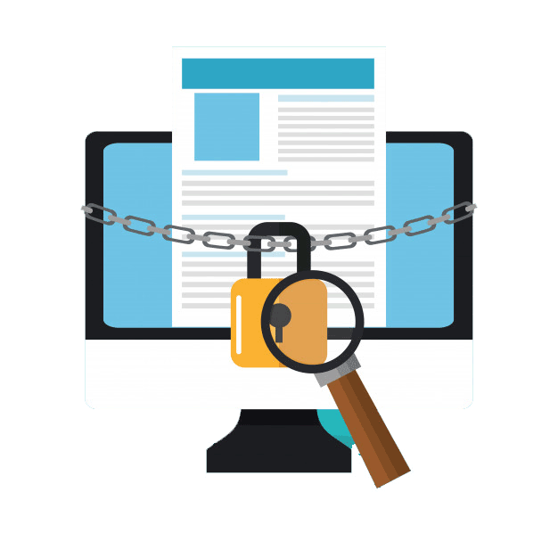
“BPO” - Records Management
According to Gartner IT Glossary
Records management (RM) technologies enable organizations to enforce policies and rules for the retention and disposition of content required for documenting business transactions, in addition to automating the management of their record-retention policies
RM principles and technologies apply to both physical and electronic content

Slide 19



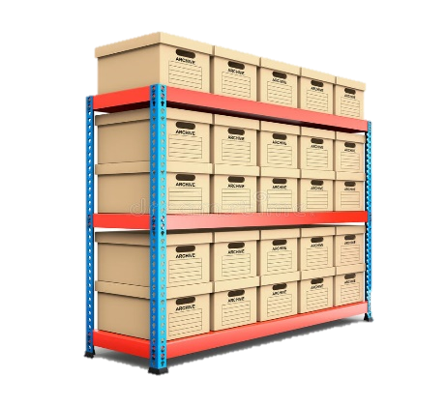




“BPO” - Records and Information Management
How it works…..
❷
Scanning & Indexing
❸
Barcoding & Archiving
❶
Receiving
❺
Shredding
❹
Retrieving

Slide 20
Mailroom Receiving
❶
Tip No. 1
Receiving documents from different branches/departments is very essential step and considered high risk if not handled/managed probably.
Our 3A Rules must be strictly applied during the Receiving stage:
Applying the most efficient and secured procedures that assure accurate receiving
Avoid any missing during transferring process with different users ( sender – mover – receiver – and records keeper)
Administer state of the art proven methodologies, polices, procedures and systems
Notes:
Instructor Notes:
See slide

Slide 21

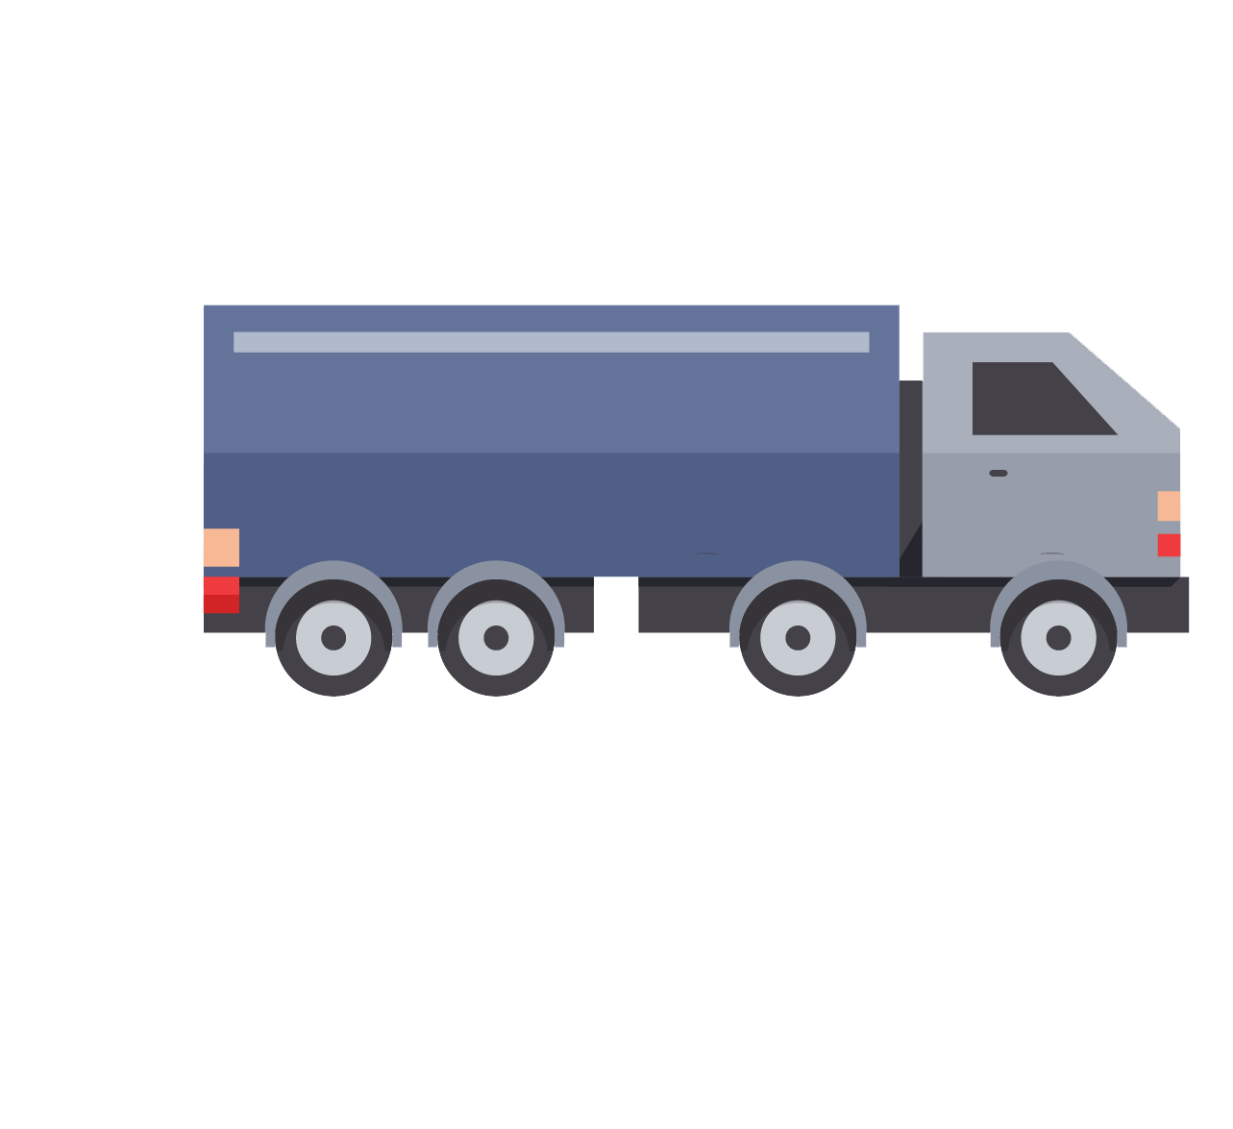



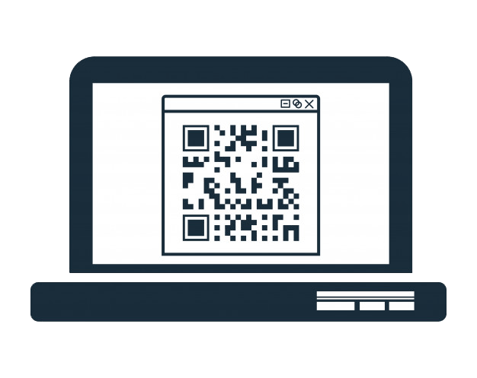

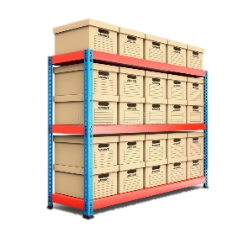
Records Management - Mailroom Receiving
Fleets (Receiving Dock)
Manifest
Moving Boxes
Loading Area
List with Received/Hold
Link Barcodes
(box-receiving Location)
Scan Box Barcode

Slide 22
Scanning & Indexing “BAU & Backlog Conversion”
❷
Tip No. 2
Be Smart when choosing the right BAU & Backlog conversion service provider, contact the provider who own the Knowledge, Resources and Updated tools that fit project nature
We - @ Namaa InfoLogistics - have certified expertise in many capture solutions supported by architects, DevOps and senior Project Managers to run the show automatically through all steps till releasing to final repository.
Be confident that Each step should be tide to solid procedures to assure the proper use of any applied tool and securing high quality and efficient output
Notes:
Instructor Notes:
See slide

Slide 23
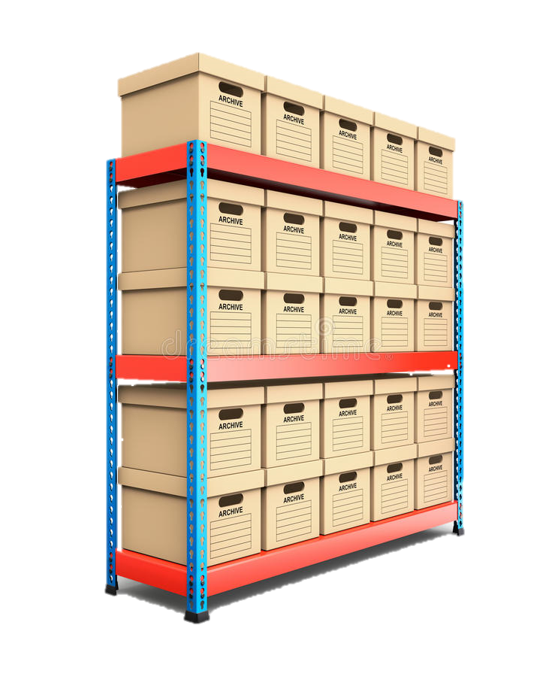
Barcoding & Archiving
❸
Tip No. 3
We received/registered records and scanned/indexed them, now we need to store on shelves in a way to assure safe, secure and ease of retrieval whenever needed by authorized personal.
We - @ Namaa InfoLogistics - apply all needed codes, systems, resources and procedures to manage this activity efficiently to ensure:
Having systemize link for relevant codes is the success key to do such sophisticated activities.
Linking all Document code to box code and eventually linked to shelve location code.
Notes:
Instructor Notes:
See slide

Slide 24



Records Management - Barcoding & Archiving
Register Barcode in WHMS
Moving boxes from Mailroom/Scanning Area
Send list to Storing team
Link box Barcode and Shelf Barcode with Handheld Scanner
Link Barcodes
(file - boxes-Location)

Slide 25
❹
Retrieving
Tip No. 4
As we have all documents/boxes registered in the system as planned, we guarantee that Retrievals will be systemized and efficient.
Having multimillions document is not an issue, we know each and single document location and can get documents within few minutes based on retrieval volumes.
Notes:
Instructor Notes:
See slide

Slide 26
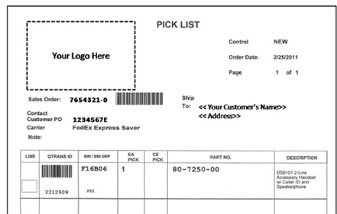
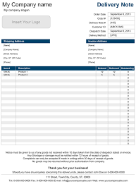
Records Management - Retrieving
Retrieval request
Prepare retrieval list in system
Send list to retrieval team
Scan box & Area barcode
Unlink box to shelves & Link box to retrieval Area
Delivery Note “Prepare & Sign”
Send notification to requester

Slide 27
❺
Shredding
Tip No. 5
No It is time to protect the privacy of your information by destroying paper records and documents in a safe and compliant way.
We - @ Namaa InfoLogistics – provide shredding service that professionally:
Safeguard your organization’s reputation by securely shredding sensitive and confidential documents.
Reduce costs by shredding documents no longer needed, useful or necessary.
Ensure compliance by shredding documents in accordance with the government and industry regulations and retention periods to avoid penalties, fines or legal action.
Notes:
Instructor Notes:
See slide

Slide 28




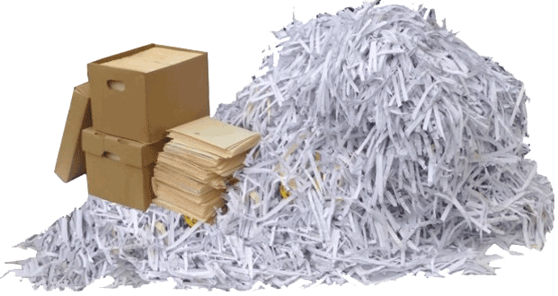
Records Management - Shredding
Destruction request
Get Approval (as needed)
Prepare retrieval list in system
Send list to retrieval team
Scan box & Area barcode
“Unlink box to shelves & Link box to Destruction Area”
Shredding Certificates supported by “Video & Committee” evidence
Shred documents
Prepare & Sign Destruction form
Send notification to the requester

Slide 29

IT Outsourcing
Outsourcing services is the best idea for organizations to focus on what they are experts in and outsourcing what others can
Namaa InfoLogistics staffing outsourcing services having the means and techniques required to locate top resources for different IT positions
How it works…..

Slide 30







“BPOs” – IT Outsourcing
Outsourcing services is the best idea for organizations to focus on what they are experts in and outsourcing what others can
Namaa InfoLogistics staffing outsourcing services having the means and techniques required to locate top resources for different IT positions
How it works…..
Gathering
Requirements
Candidates
Sourcing
HR and Technical interview
Employer Final interview
①
②
③
④
Employees Onboarding
job offer
and Contracts
Employees Replacement
⑦
⑥
⑤

Slide 31
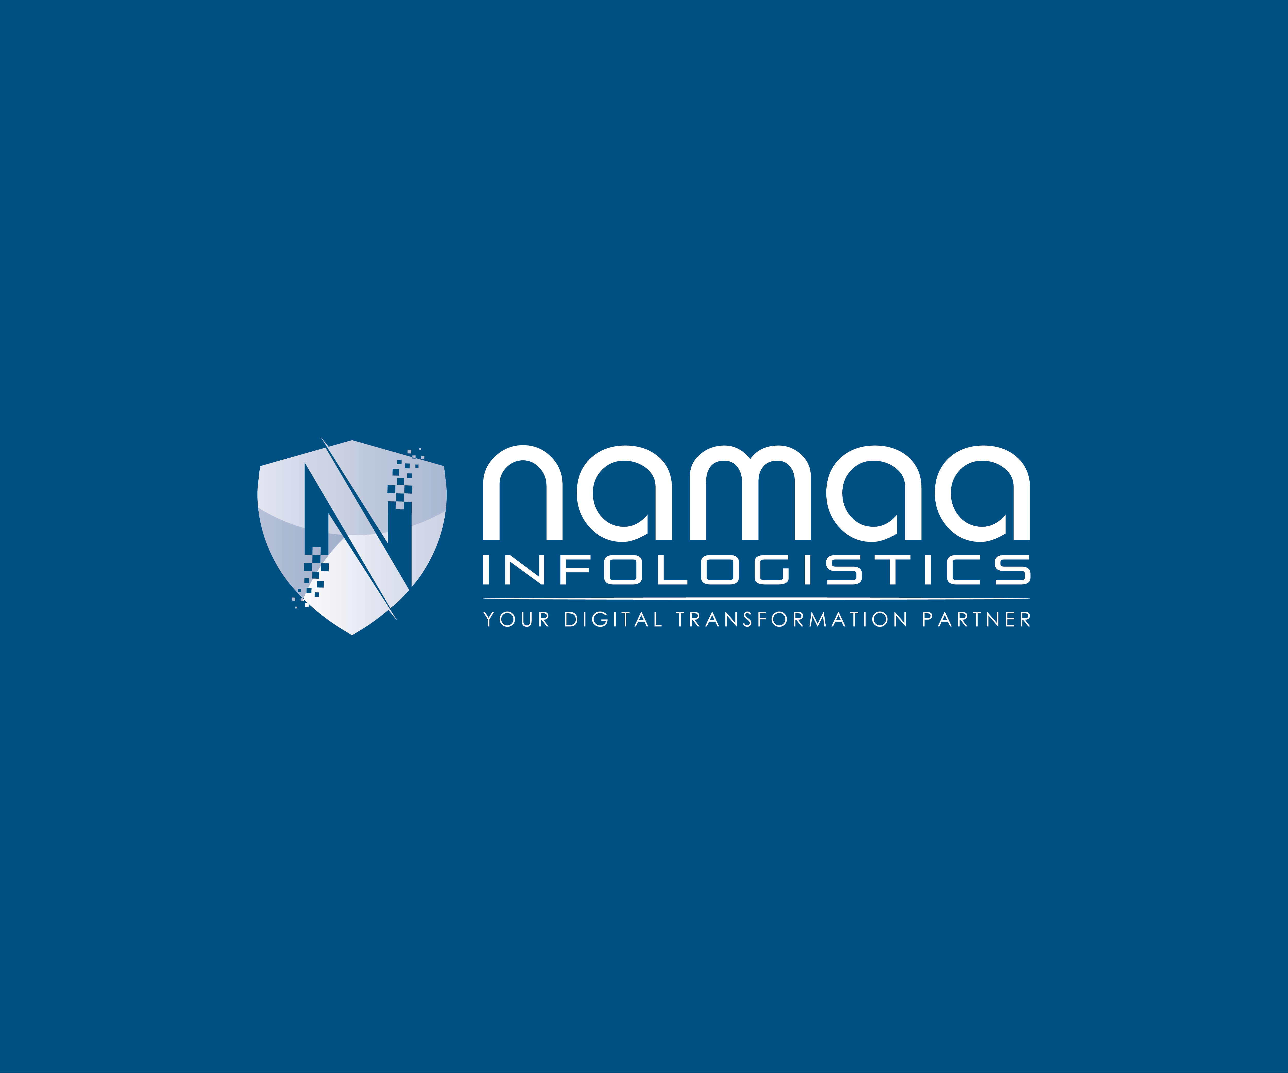




Thank You
info@namaa-il.com
76 El Tayaran St., Nasr City, Cairo, Egypt
https://www.linkedin.com/company/namaa-infologistics
https://namaa-il.com/

